Slide 1


Introduction to Advanced Actor-Critic Methods
Overview
Actor-critic methods are a class of algorithms in reinforcement learning that combine the benefits of value-based and policy-based approaches. They consist of two main components: the actor, which proposes actions, and the critic, which evaluates them.
Significance
Versatility: These methods can effectively handle various types of environments, including those with continuous action spaces.
Foundation for Advanced Techniques: Understanding actor-critic methods is essential for grasping more complex algorithms in reinforcement learning.

Slide 2
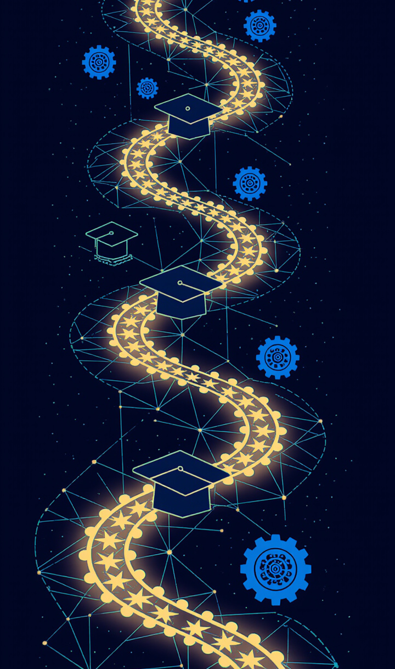
Importance of Understanding Advanced Techniques
Mastering advanced techniques in reinforcement learning is crucial for you as it lays the groundwork for future applications in diverse fields such as robotics, finance, and healthcare.
Key Points:
Career Opportunities: Proficiency in these techniques can enhance job prospects in AI and machine learning.
Research Applications: Advanced methods are often at the forefront of research, contributing to innovative solutions.

Slide 3
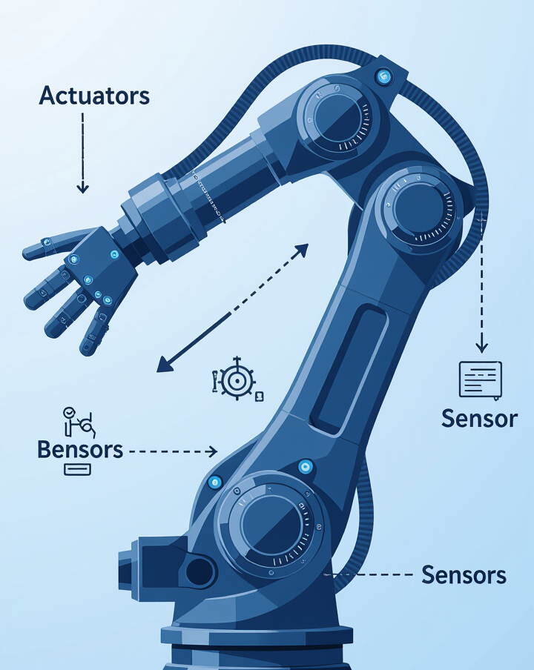
Deep Deterministic Policy Gradient (DDPG)
Introduction to DDPG
DDPG is a prominent actor-critic method designed for environments with continuous action spaces. It leverages deep learning to approximate both the policy and value functions.
Relevance
Continuous Action Spaces: DDPG excels in scenarios where actions are not discrete, making it applicable in real-world tasks like robotic control.

Slide 4
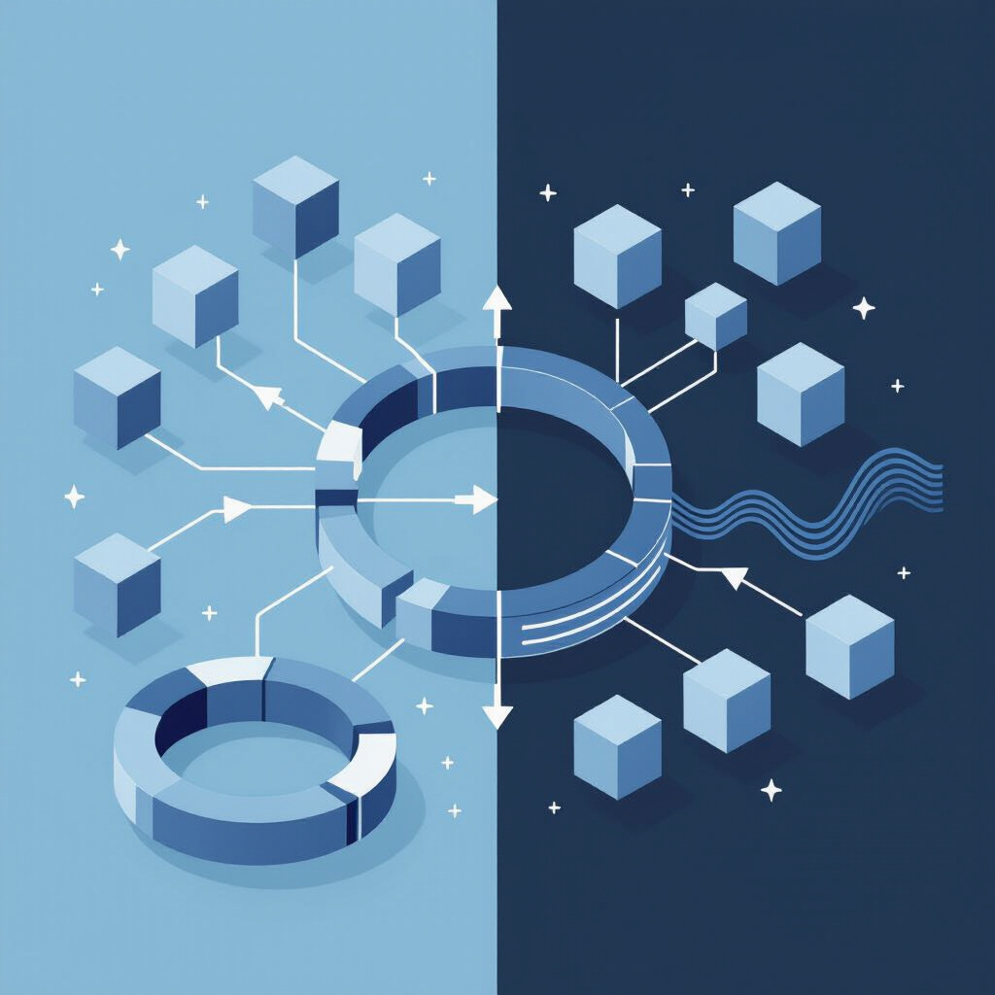
Differences from Traditional Actor-Critic Methods
Unique Features of DDPG: DDPG distinguishes itself from traditional actor-critic methods through several key innovations:
Deterministic Policy: Unlike traditional methods that use stochastic policies, DDPG employs a deterministic policy for action selection.
Experience Replay: DDPG utilizes experience replay to improve learning efficiency by reusing past experiences.

Slide 5

Continuous Action Space Applicability
Importance of DDPG's Capability: DDPG's ability to handle continuous action spaces is critical for various applications:
Robotics: Tasks such as robotic arm manipulation require precise control over continuous actions.
Autonomous Vehicles: Continuous steering and acceleration adjustments are essential for safe navigation.

Slide 6

Components of DDPG
Key Components Breakdown: Understanding DDPG involves familiarizing oneself with its core components:
Actor Network: Responsible for generating actions based on the current policy.
Critic Network: Evaluates the actions taken by the actor using the Q function.

Slide 7
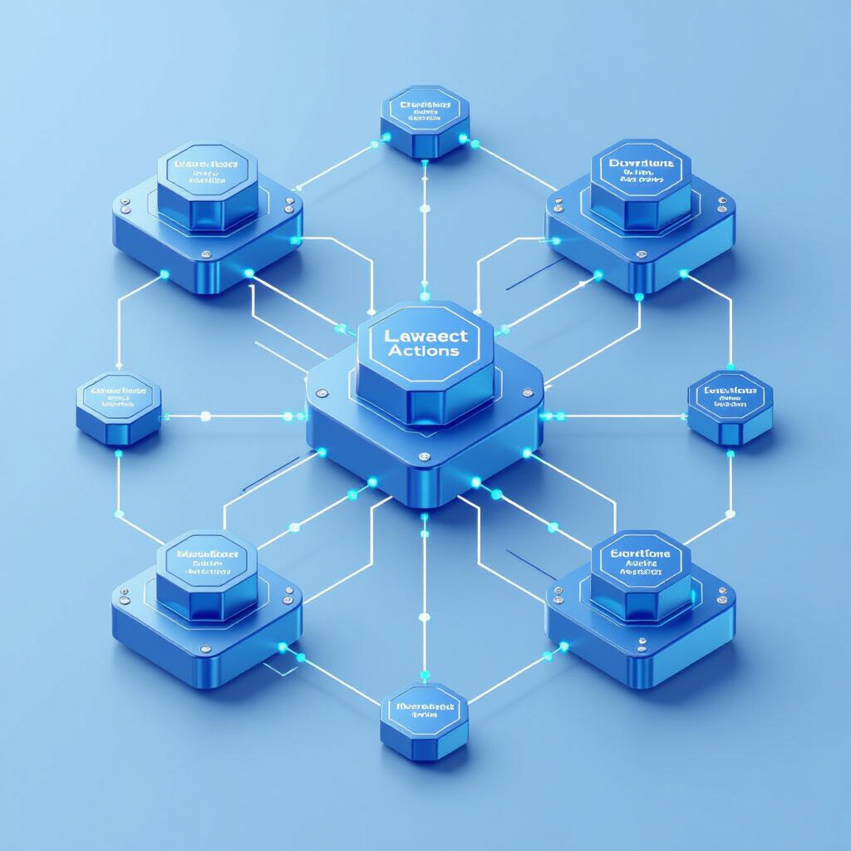
Actor Network: Policy Network's Role
Learning Objectives: The actor network in DDPG plays a crucial role in determining the policy:
Action Generation: It outputs actions based on the current state of the environment.
Policy Improvement: The actor network is updated to maximize expected rewards through policy gradient methods.

Slide 8

Critic Network: Value Network's Evaluation Process
Evaluating Actions: The critic network assesses the actions taken by the actor:
Q Function: It estimates the expected return of taking a specific action in a given state.
Importance: The critic's feedback helps refine the actor's policy, ensuring improved decision-making over time.

Slide 9
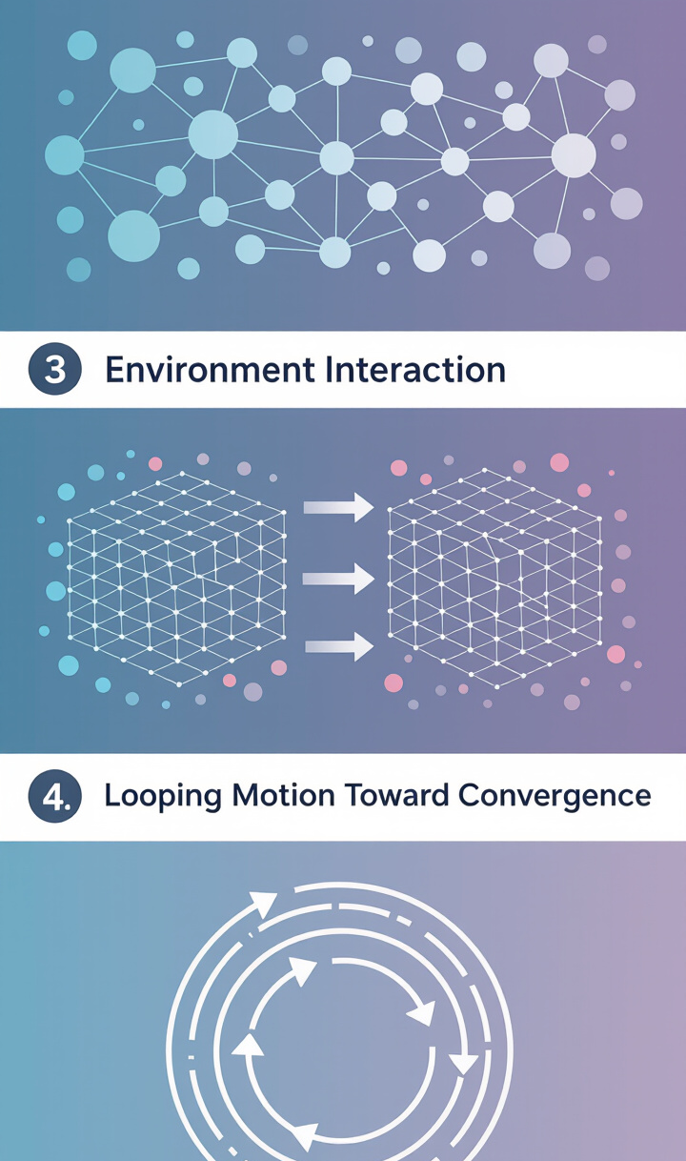
DDPG Algorithm Steps
Framework for Understanding: The DDPG algorithm follows a structured process:
Initialize networks: Set up the actor and critic networks with random weights.
Collect experience: Interact with the environment to gather state, action, reward, and next state data.
Update networks: Use collected experiences to update the actor and critic networks.
Repeat: Continue the process until convergence.

Slide 10

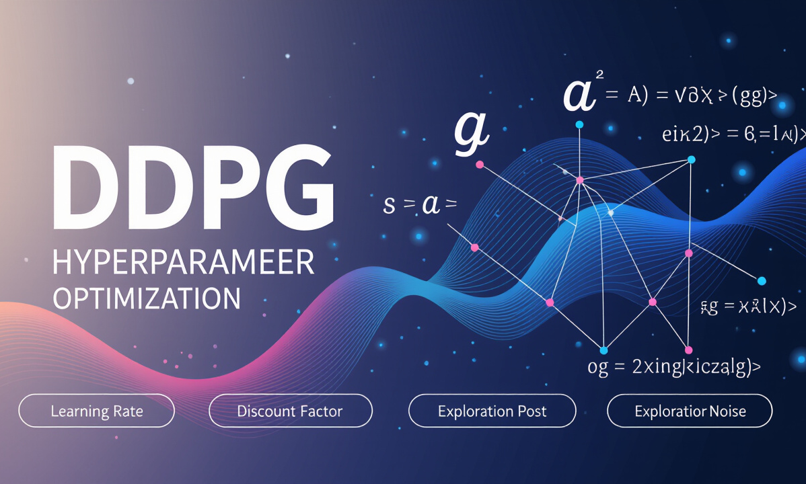
Initialization of Networks and Parameters
Initial Setup Importance
Optimizing Performance
The initial setup of networks and parameters is vital for DDPG's success. Key aspects include Network Architecture, where appropriate architectures for the actor and critic networks must be chosen to ensure effective learning, and Hyperparameters, which involve setting learning rates, discount factors, and exploration noise levels to optimize performance.
Setting the right Hyperparameters is essential. This includes optimizing learning rates, discount factors, and exploration noise levels, which directly impact the performance of DDPG.

Slide 11


Action Selection and Exploration Strategy
Effective Action Selection
Balancing Exploration and Exploitation
Effective action selection and exploration are crucial in DDPG. One strategy is to add Exploration Noise (e.g., Ornstein-Uhlenbeck process) to the actor's output to encourage exploration of the action space.
It is important to balance exploration and exploitation. Encourage audience interaction by discussing potential methods for exploration, which can lead to a deeper understanding of DDPG.

Slide 12

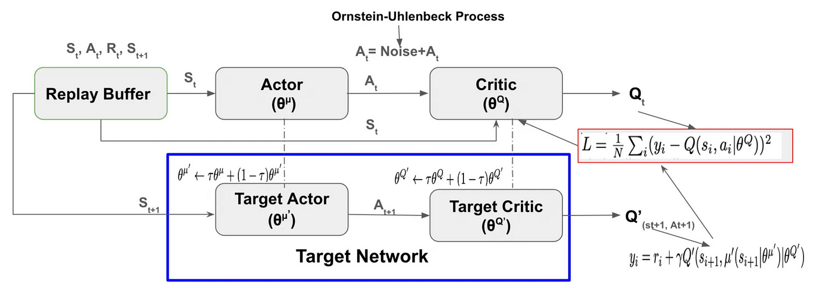
Critic and Actor Network Updates
Updating Networks
Encouraging Questions
The update process for the actor and critic networks involves two main updates: Critic Update, which uses gradient descent to minimize the loss between predicted and target Q values, and Actor Update, which utilizes policy gradient ascent to maximize the expected return based on the critic's evaluation.
Inviting questions about the mathematical foundations and practical implications of these updates can enhance audience engagement and understanding.

Slide 13
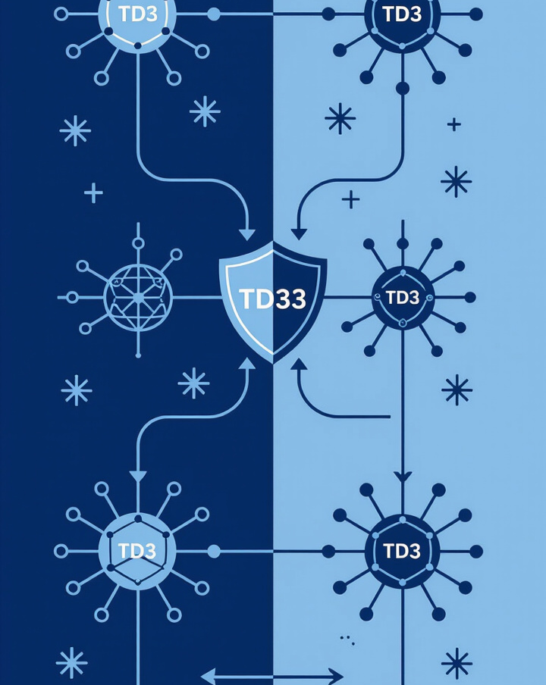
Twin Delayed Deep Deterministic Policy Gradient (TD3)
Introduction to TD3
TD3 is an evolution of DDPG that addresses some of its limitations, enhancing stability and performance.
Relevance
Robustness: TD3 improves learning efficiency and reduces variance, making it more reliable in practice.

Slide 14
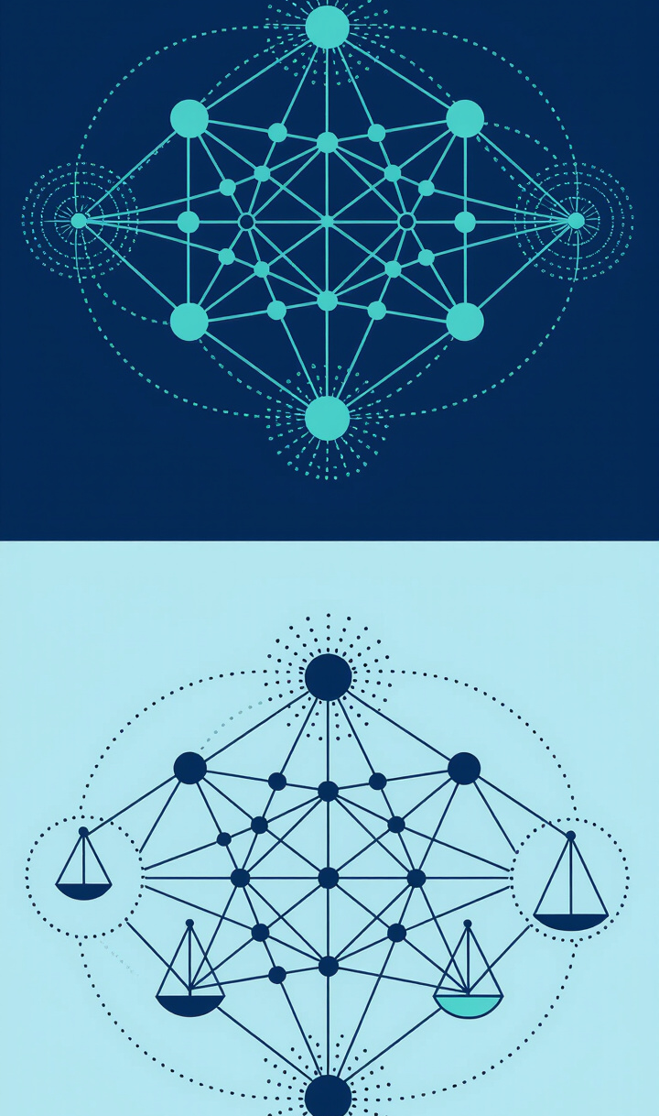
Improvements Over DDPG
Specific Enhancements: TD3 offers several improvements over DDPG:
Double Q-Learning: Reduces overestimation bias by using two critic networks.
Target Policy Smoothing: Adds noise to the target policy to improve stability during updates.

Slide 15
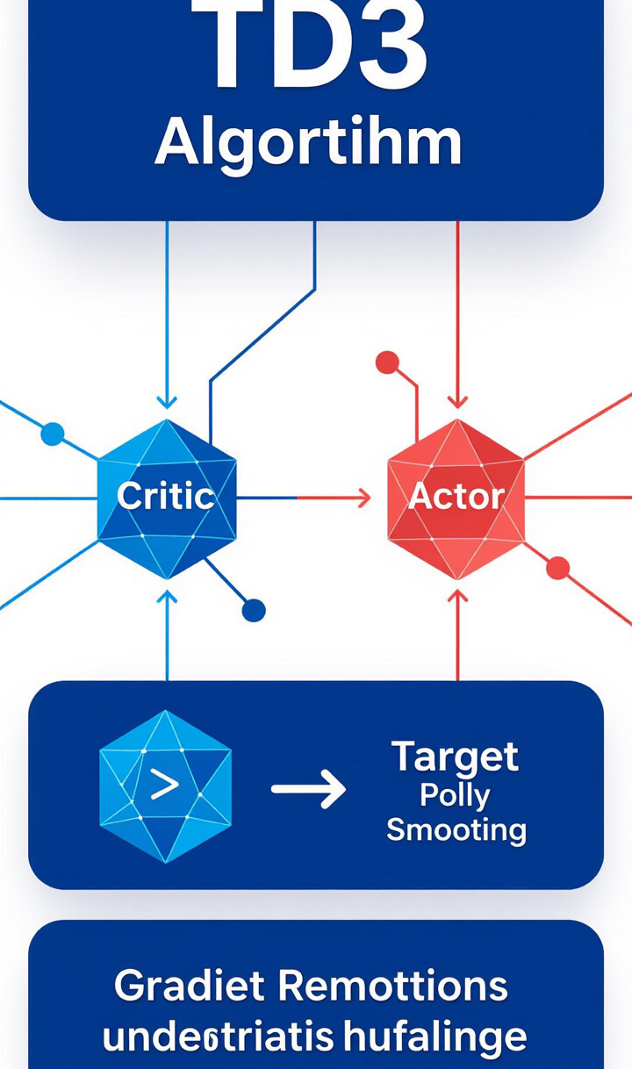
TD3 Algorithm
Unique Aspects: The TD3 algorithm builds on DDPG with its unique features:
Two Critic Networks: Use two separate critic networks to mitigate overestimation.
Delayed Updates: Update the actor network less frequently than the critic networks to enhance stability.

Slide 16
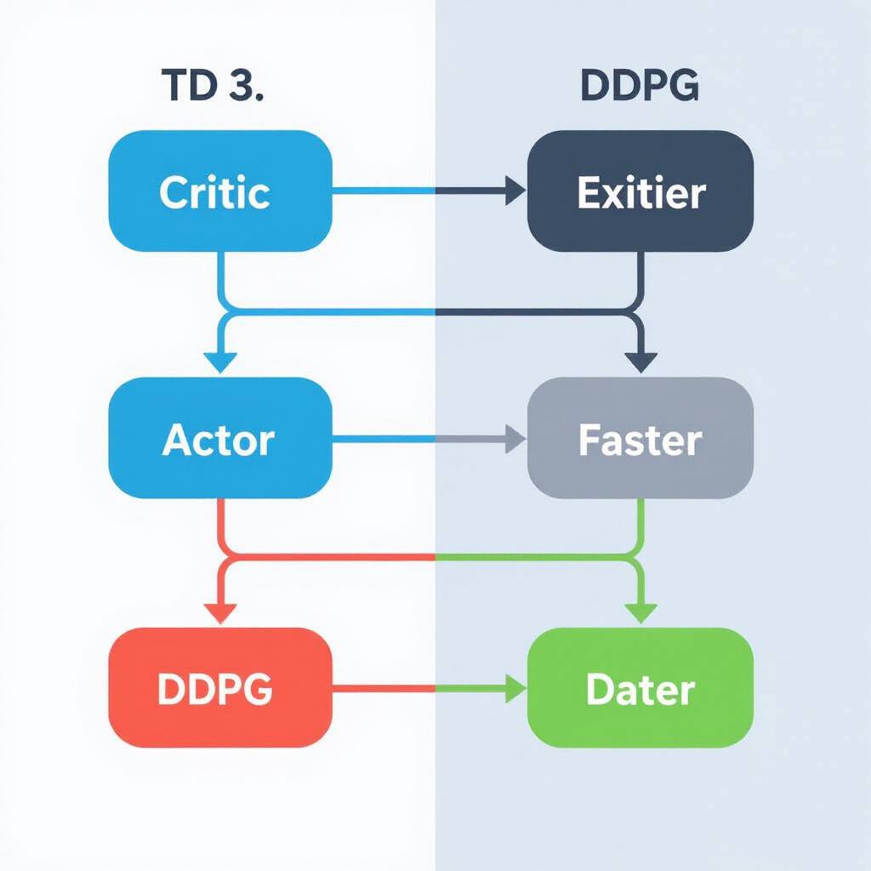
Unique Aspects of TD3 Compared to DDPG
Advantages: How do the improvements in TD3 contribute to better performance in continuous action tasks?
Considerations: What challenges might still exist despite these enhancements?

Slide 17
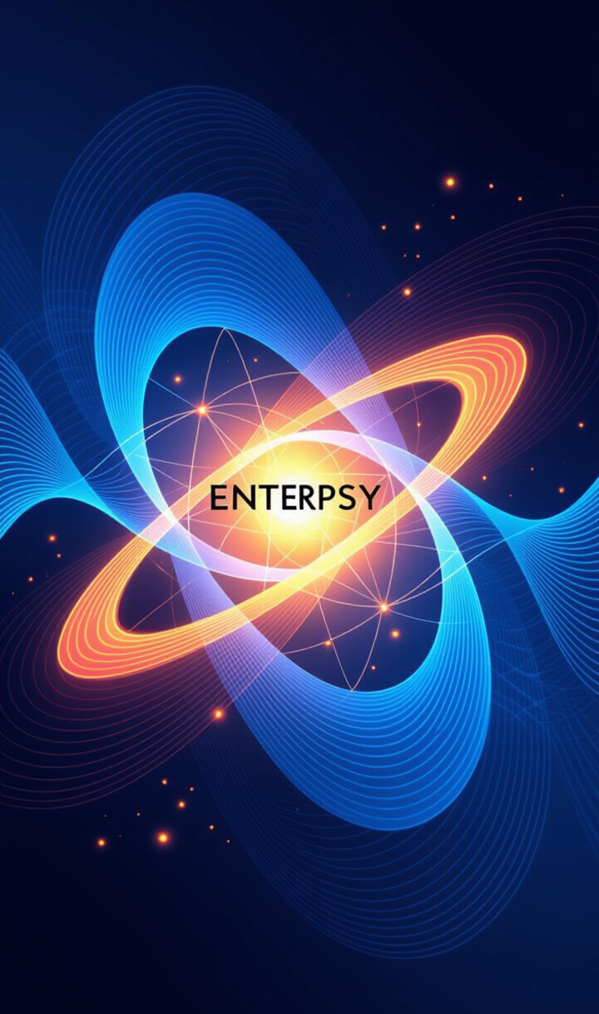
Soft Actor-Critic (SAC)
SAC is another advanced actor-critic method that incorporates innovative approaches to reinforcement learning.
Emphasis on Exploration:
Entropy Regularization: SAC uses an entropy term in its objective function to encourage exploration.

Slide 18
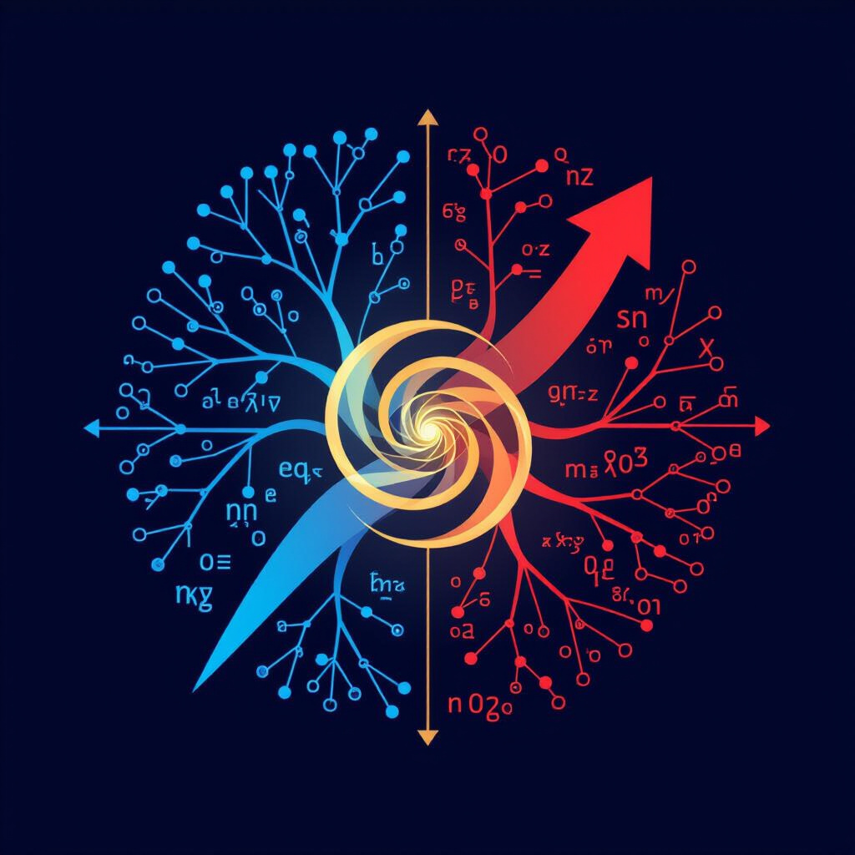
Use of Entropy in the Objective Function
Balancing Exploration and Exploitation: The role of entropy in SAC's objective function is crucial:
Encouraging Exploration: The entropy term promotes diverse action selection, preventing premature convergence to suboptimal policies.
Improving Learning Dynamics: This balance enhances the overall learning process.

Slide 19

Components of SAC
Key Components Breakdown: Understanding SAC involves familiarizing oneself with its core components:
Actor Network: Generates actions while considering the entropy term.
Critic Network: Evaluates actions based on the Q function, similar to DDPG but with added complexity.

Slide 20

Actor and Critic Roles in SAC
Distinct Roles: The actor and critic in SAC have specific roles:
Actor: Focuses on generating actions that maximize expected returns while maintaining exploration.
Critic: Evaluates the quality of actions and guides the actor's learning process.

Slide 21

Importance of Entropy Term
Influencing Learning Dynamics: The significance of the entropy term in SAC cannot be overstated:
Exploration Encouragement: It helps maintain a balance between exploring new actions and exploiting known rewarding actions.
Robust Learning: This dynamic allows SAC to adapt more effectively to complex environments.

Slide 22

SAC Algorithm Steps
Detailed Explanation: The SAC algorithm follows a structured process:
Initialize networks: Set up the actor and critic networks with appropriate architectures.
Collect experience: Interact with the environment and gather data.
Update networks: Use experiences to update both the actor and critic networks.
Repeat: Continue the process until convergence.
Encouraging Engagement: Encourage audience engagement by asking questions about the algorithm's steps and their implications.

Slide 23
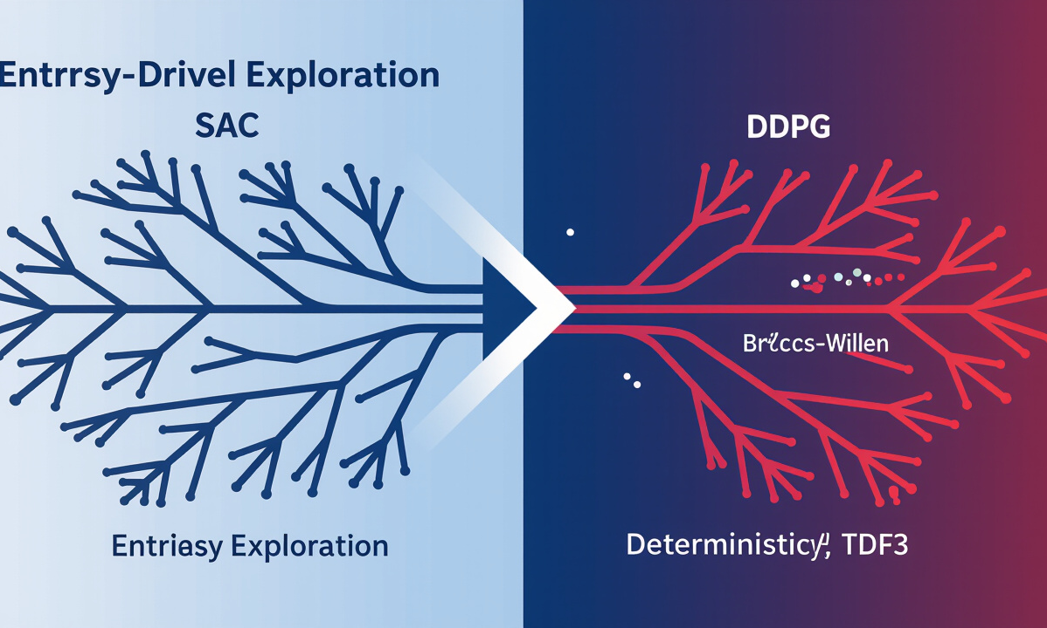
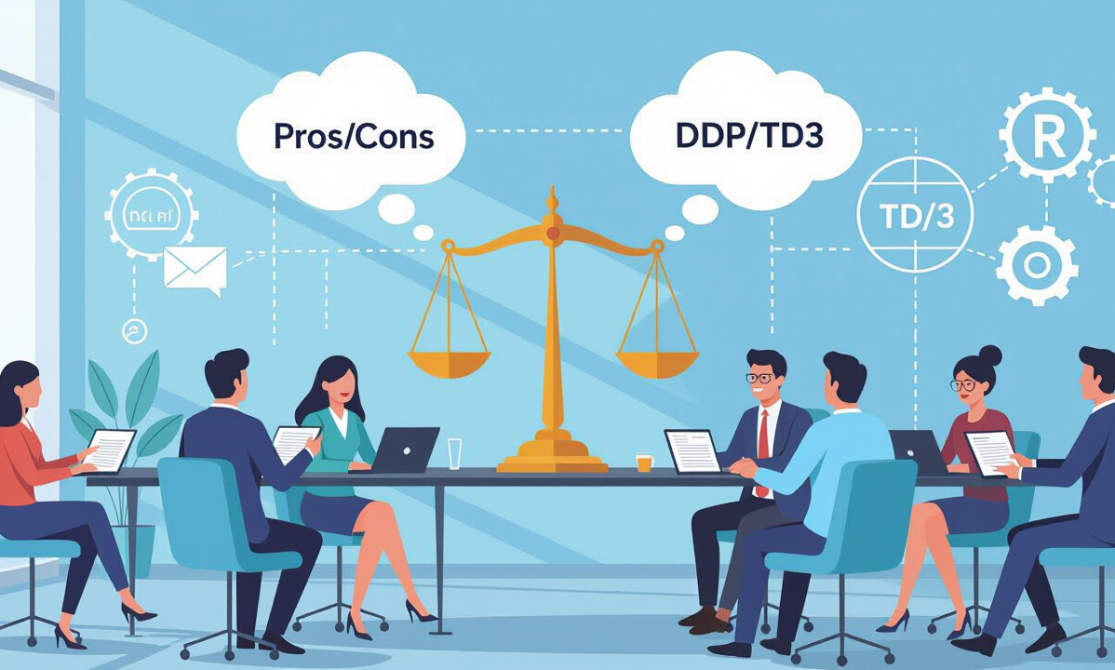
Contrast with Deterministic Methods
Exploration vs. Determinism
Implications and Audience Reflections
In conclusion, contrasting SAC with deterministic methods like DDPG and TD3 reveals significant differences: SAC's emphasis on exploration through entropy contrasts with the deterministic nature of DDPG and TD3.
the potential advantages and disadvantages of each approach in various applications.

